Slide 1
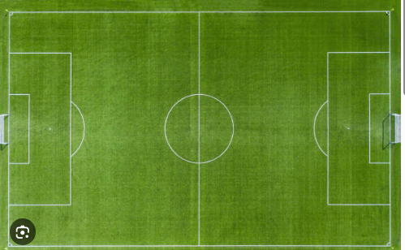

Football Player Performance And Valuation Analysis MOHAMED ALDOSERI
Transfer market and Performance

Slide 2






Outlines
Defining The Problem Statement
Aims and Objectives
Contents of The Dataset
Insights
Resolutions
✅
Target Audience
Tools To Be Used

Slide 3


Problem Statement
We analyze performance statistics player performance and consistency in Europe’s top 5 leagues (2014–2022) based on key statistics (games played, shots on target, assists, yellow cards, and goals)
The aim is to analyze key factors that influence player effectiveness and make the insights simpler for football clubs, fans and analysts to understand overall player quality and valuation.
.

Slide 4
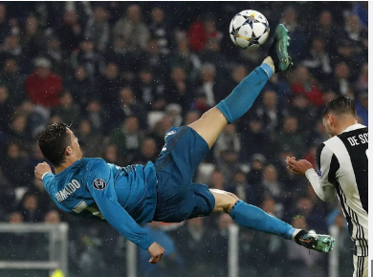
Aims and Objectives
Aim
Identify the relationship between appearance and contributions (goals/assists) and highlight league level insights. To assess key metrics used in player valuation.
Objectives
Which player had the most goals, key passes and the most assists? And from which league?
Which player played the most minutes?
Which league had the most yellow cards shown, faults, free-kicks given?
Which league recorded the highest number of goals?
The most productive players in terms for value for money.

Slide 5

Target Audience
Fans
1
Media
Researchers & Analysts
Football clubs and Scouts
7

Slide 6

Contents of The Dataset
Features : 21
League name
Minutes
Assists
Player name
Key passes
Player ID
Yellow Cards
Market Value
Goals and goal Contributions
5

Slide 7

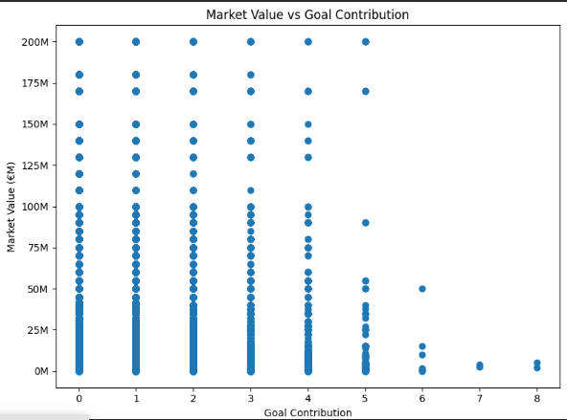
Player Insights
No Correlation between player value and goal contribution
High value of players will not guarantee more goals + assists
Explains Playing position roles.
6

Slide 8

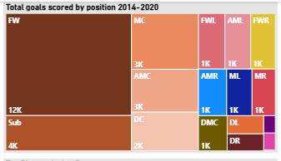
Player Insights
Forward players had the most goal Scored 2014-2020
6

Slide 9

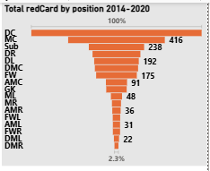
Player Insights
Defending Midfielders were the most sent off players 2014-2020
6

Slide 10

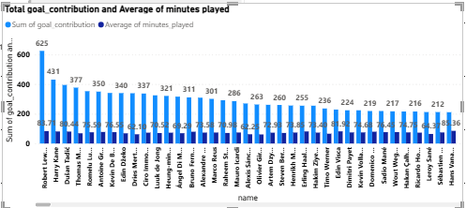
Player Insights
Robert Lewandoski, Harry Kane and Tadic tops minutes and goal contributions
6

Slide 11

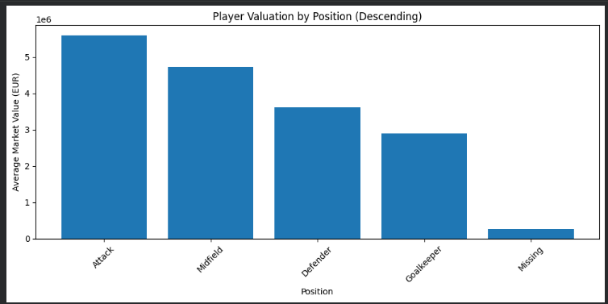
Player Position by Market Value
Attackers have the highest Market value, followed by midfielders
Goalkeepers have the lowest market value
.
6

Slide 12
Hypothesis and ANOVA
Explained Key Terms
ANOVA (Analysis of Variance)- Used to test significant difference in group means, In this case groups are positions
Sum of Squares (Sum-Sq)- This is the variation in datapoints
F-Value- Ratio of within groups differences
P-value- Probability of the results happening
Sum of Squares Total (SSQ total)- Variation in goal contribution for players across the dataset
SSQ position- Variation in goal contributions for position specific
Effect Size (η²)- Total variation ratio
6

Slide 13

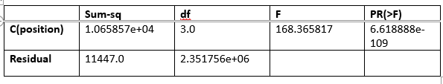
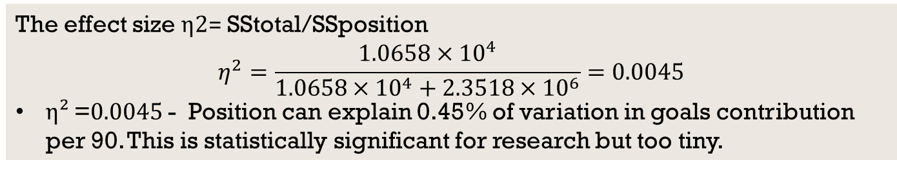
Hypothesis and ANOVA
H0: Position cannot significantly influence goal contributions per 90
The F(3, 111447) = 168.37 with p < 10⁻¹⁰⁰, are statistically significant
The effect size η2= SStotal​/SSposition​​
$$η^{2}=\frac{1.0658×{10}^{4}}{1.0658×{10}^{4}+2.3518×{10}^{6}}=0.0045$$
η² =0.0045 - Position can explain 0.45% of variation in goals contribution per 90. This is statistically significant for research but too tiny.
6

Slide 14

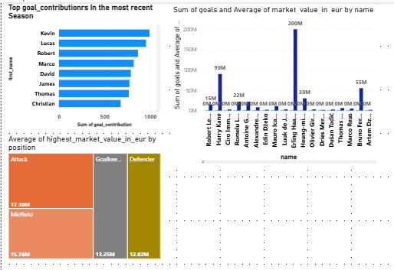
Player Insights
Haaland, Harry Kane and Bruno Fernandez the most valuable players with the most goals
Attackers highest Market Value
In the most recent seasons, Kevin Debruyne, Lucas and Lewandoski are the top goal contributors
6

Slide 15
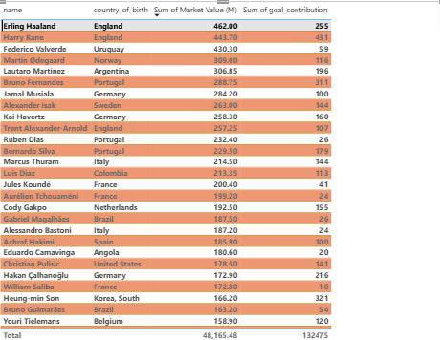
Player Insights
Haaland, Harry Kane and Federico Valverde tops the list of player value
Kane and Haaland also have big numbers in terms of goal contributions for the recent seasons.
6

Slide 16
Resolution and Conclusion
Conclusion:
Player value depends on performance pattern, it is not a random occurrence
Age impacts negatively on footballer’s value.
Height can be a bonus attribute
Based on the ANOVA, player roles are value neutral, position significantly influence goal contribution per 90
Transfer market value id driven by productivity
Generally, football valuation is statistics as they say numbers don’t lie.
Market value is weighted score of scoring ability, creativity, consistency and play time of youth age and physical

Slide 17



Tools To Be Used
8

